Slide 1

Software Test Automation Group (STAG)
Nuances of Python Test Automation
By Vivek Bhardwaj

Slide 2
Agenda
Is python famous ?
Why and some python libraries
unittest and pytest
Behave for BDD
Questions and Suggestions

Slide 3
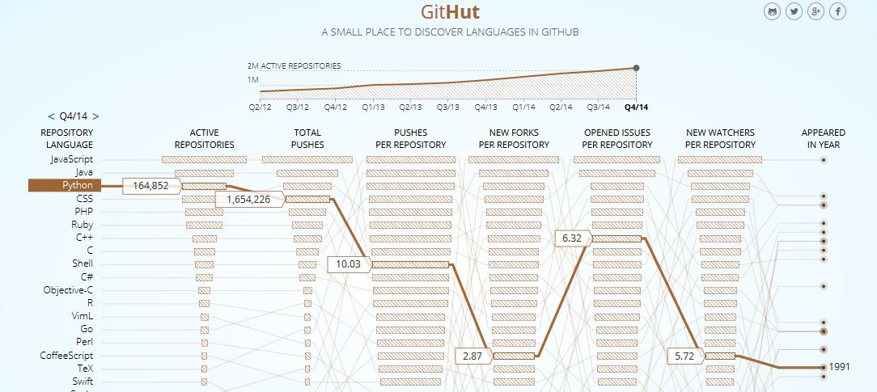
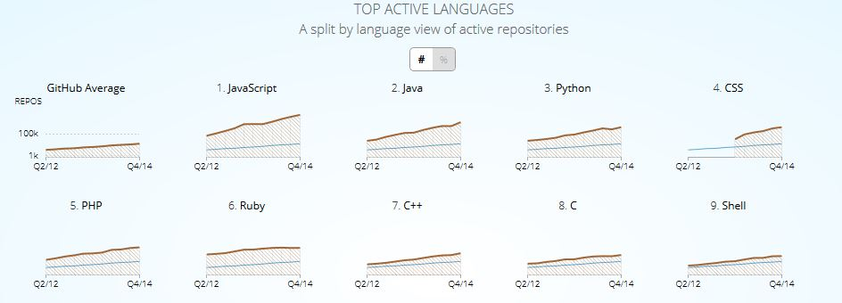
Sources: Link1 Link2 Link3

Slide 4
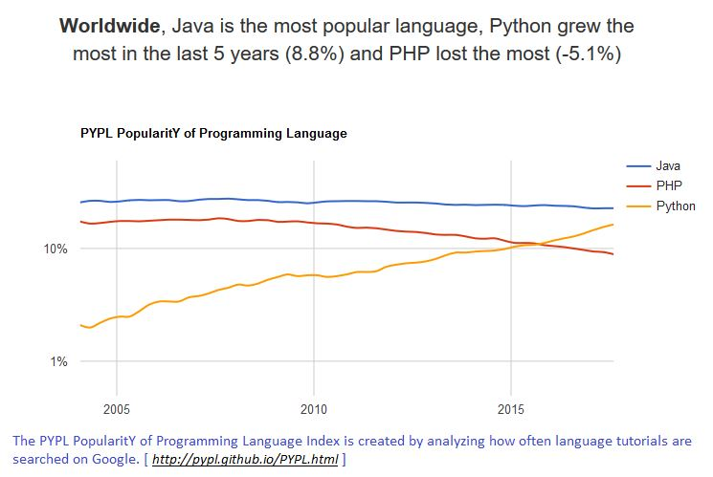
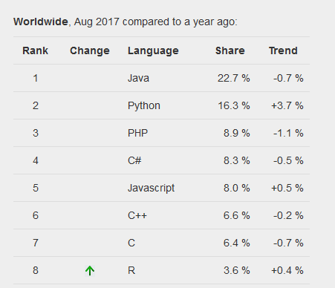

Slide 5
Why python ?
Python was built from the beginning to emphasize readability
Allows you to develop quickly with lesser code click
Massive third-party library support: Python Package Index, the official repository containing third-party software for Python, contains over 107,000 packages
Libraries such as NumPy, SciPy and Matplotlib allow the effective use of Python in scientific computing
It was ranked as Programming Language of the Year for the year 2007 and 2010.
Python started earlier and has massive active community support :For instance, Ruby was influenced by Python click

Slide 6
Some cool features of python
pandas
numpy
Requests
Unittest
pytest

Slide 7
Installation
Install python (mac/linux:default; windows: download)
Install pycharm IDE
pip install package-name : pip is python package mgmt. system to install python packages (same as gem install gem-name in Ruby)
pip install -r requirements.txt : To install packages specified in the requirements.txt file (same as Gemfile in Ruby)
[Optional] jupyter notebook : Is an interactive env. to run and visualize python code.
[optional] pip install virtualenv :virtualenv is a tool to create isolated Python environments. virtualenv creates a folder which contains all the necessary executables to use the packages that a Python project would need
Pip freeze: get installed packages in requirements format

Slide 8
References:
Comparisons with other languages
Quotes about python

Slide 9

Questions?

